Slide 1





Synthetic Genomics Data Generation And Evaluation For The Use Case Of Benchmarking Somatic Variant Calling Algorithms
Styliani – Christina Fragkouli
PhD Candidate

Slide 2
Motivation
Variant calling plays an important in identifying genetic lesions.
In the case of variants at low frequency (≤10%) identification becomes more challenging.
The challenge that rises is the absence of a ground truth for reliable and consistent identification and benchmarking.

Slide 3
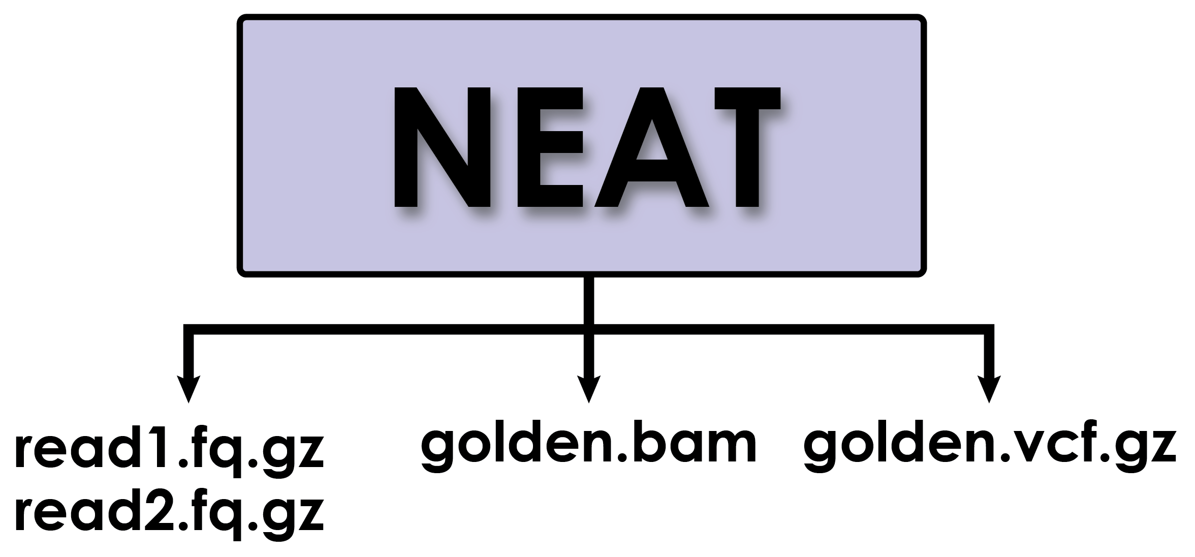

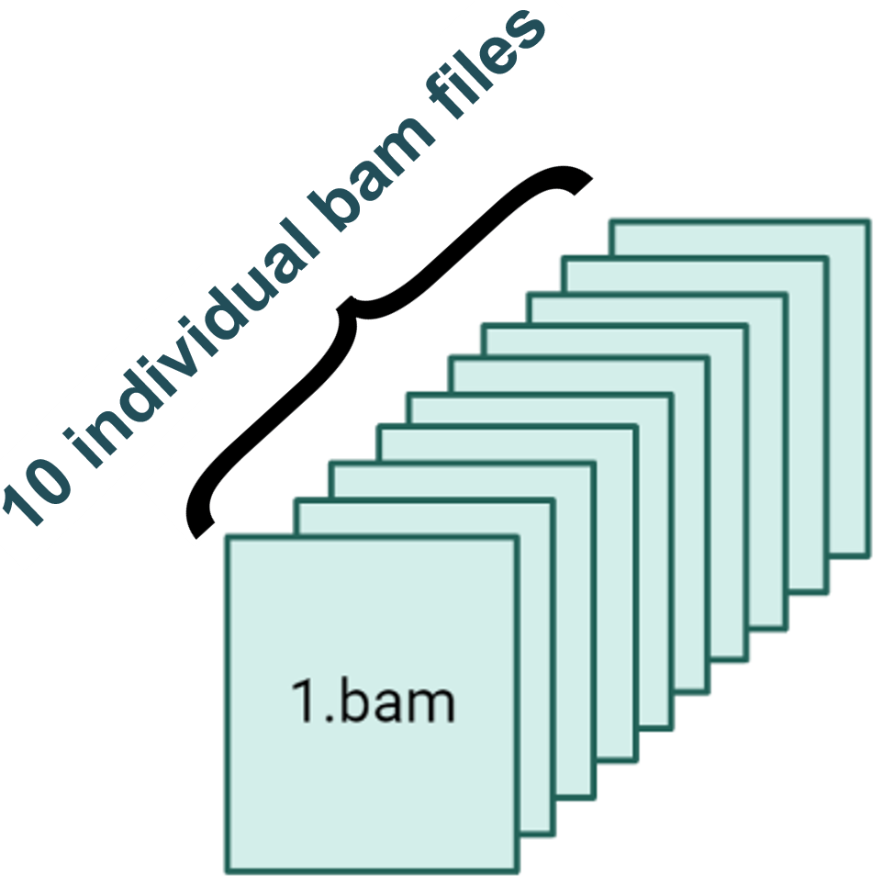
Synthetic «Gold Standard» Dataset Generation
x500 coverage
“Gold Standard” Variants of
100% Allele Frequency
x5000 coverage
“Gold Standard” Variants of
10% Allele Frequency

Slide 4

Comparing Algorithms
In-silico generated dataset that contains «Ground Truth» SNIPs and INDELs
Results from GATK somatic variant calling algorithm
VS
Mutect2

Slide 5
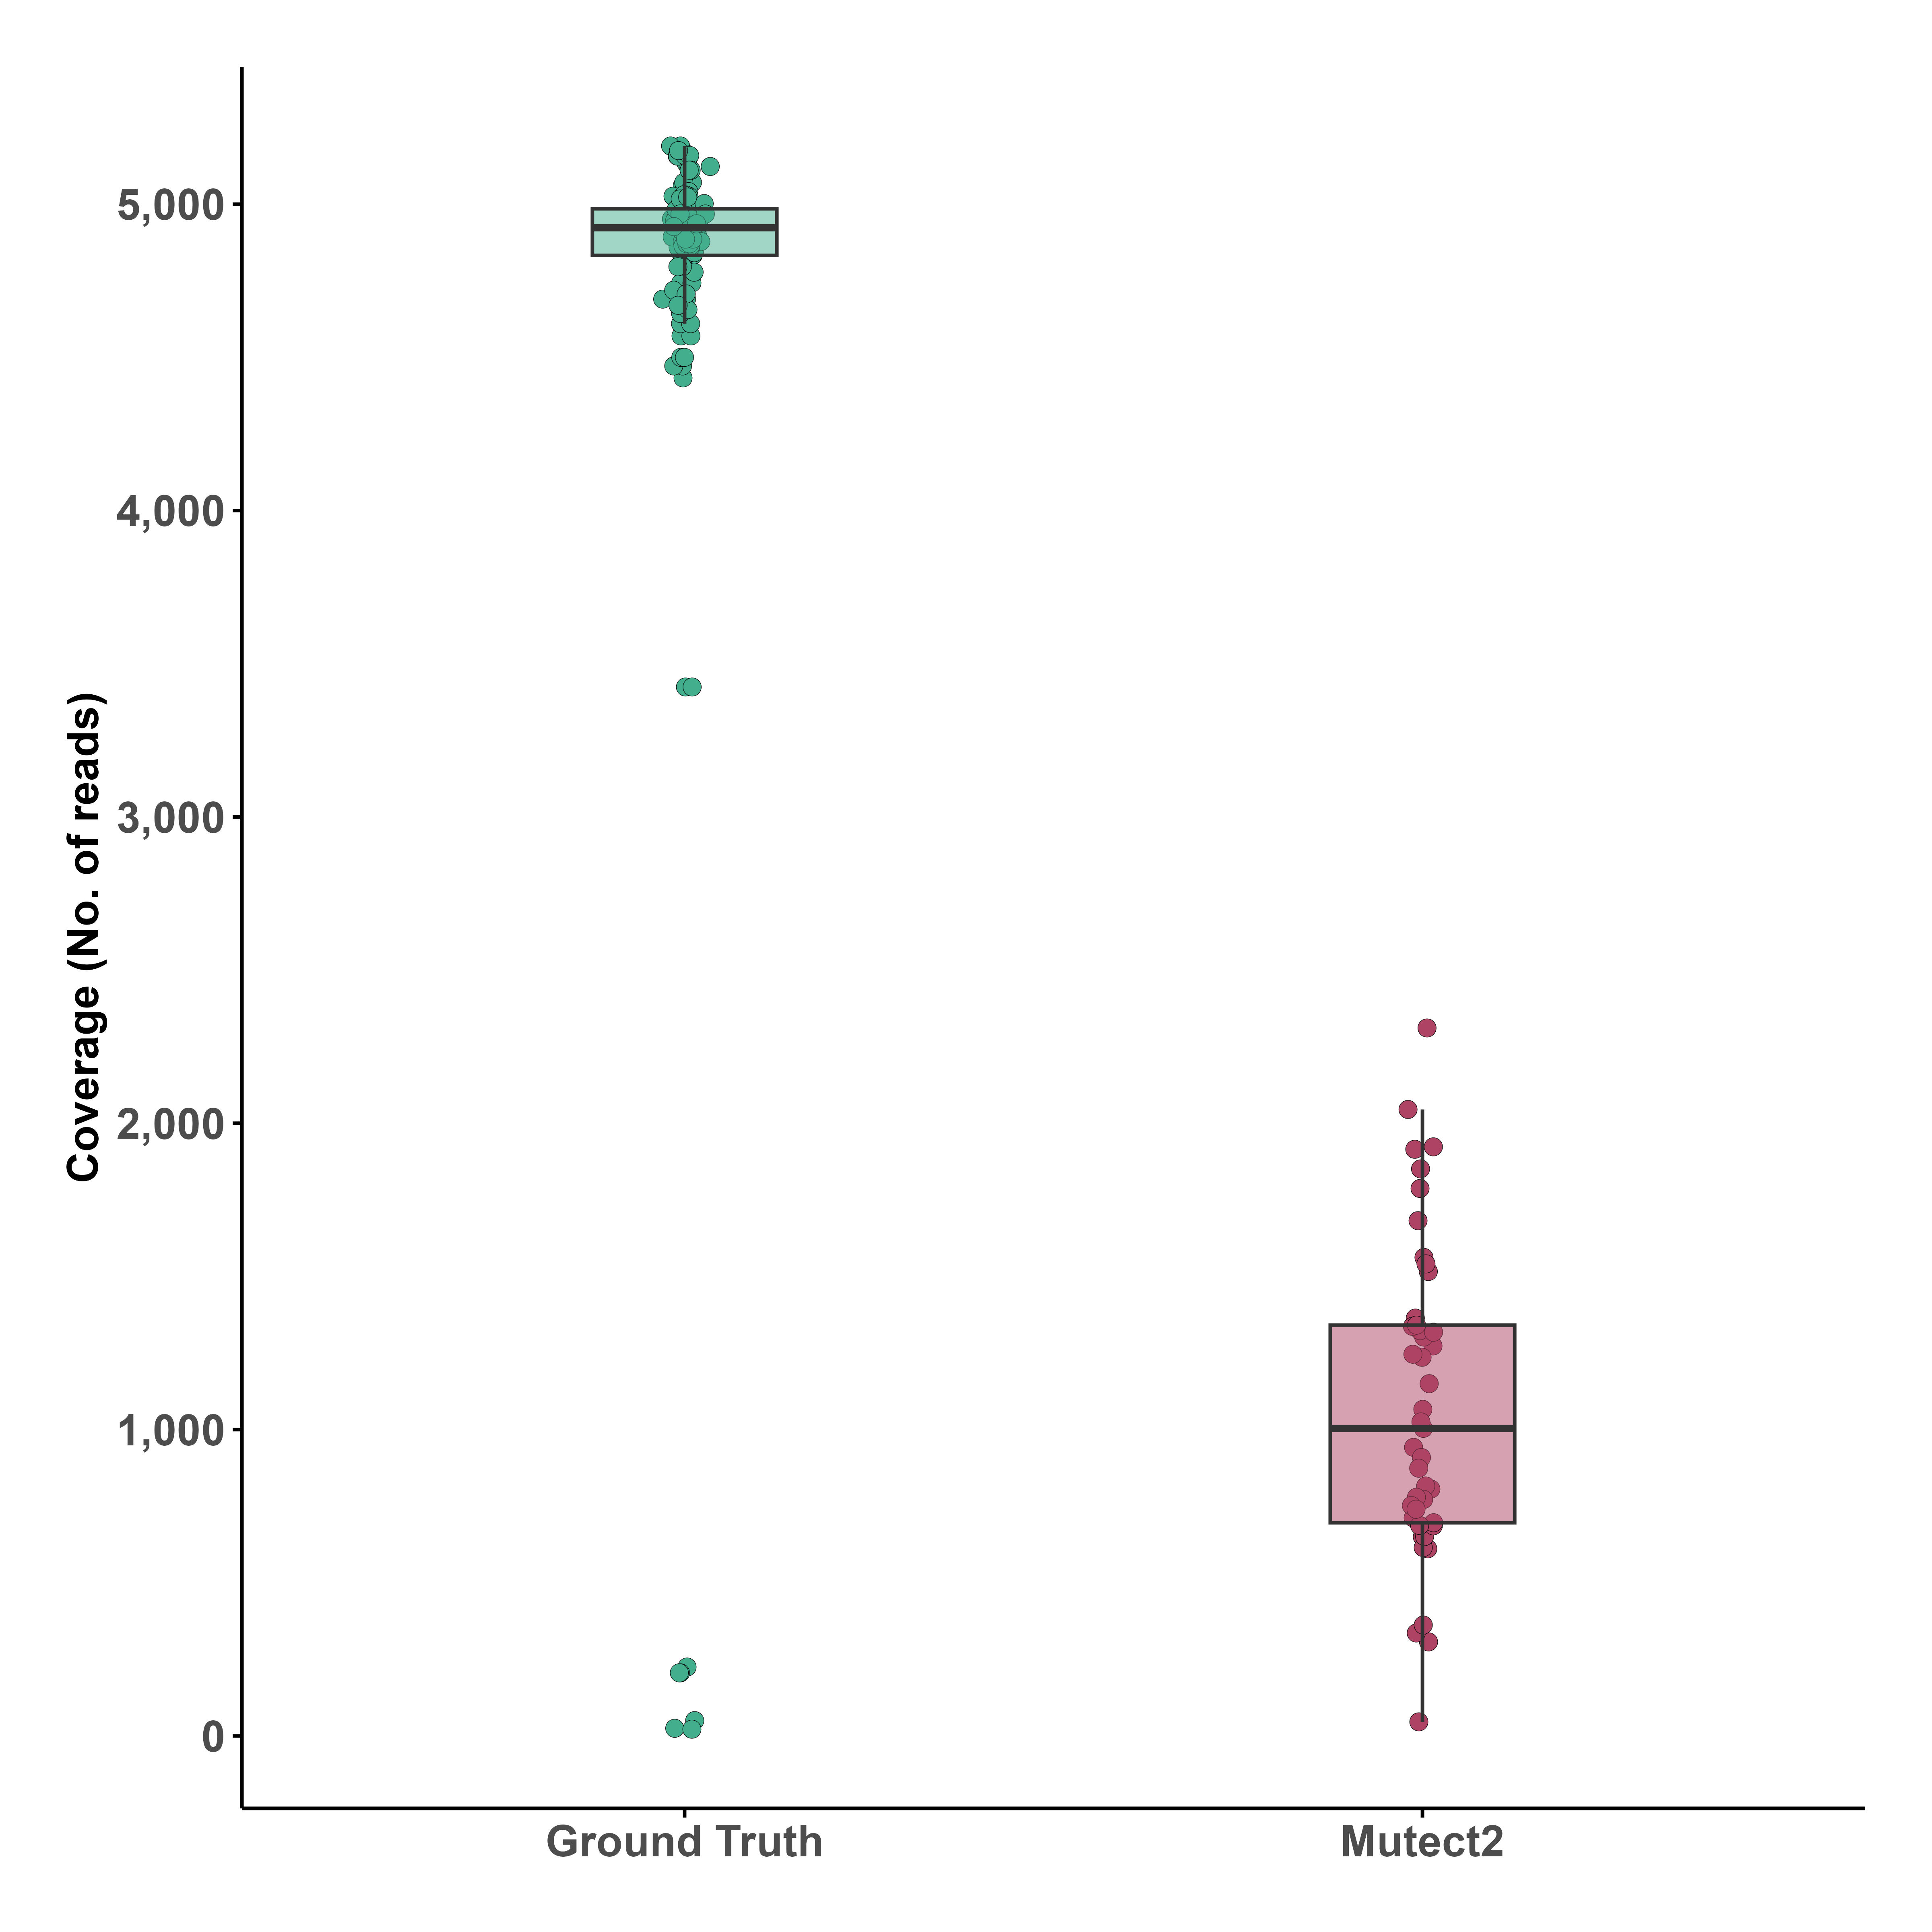
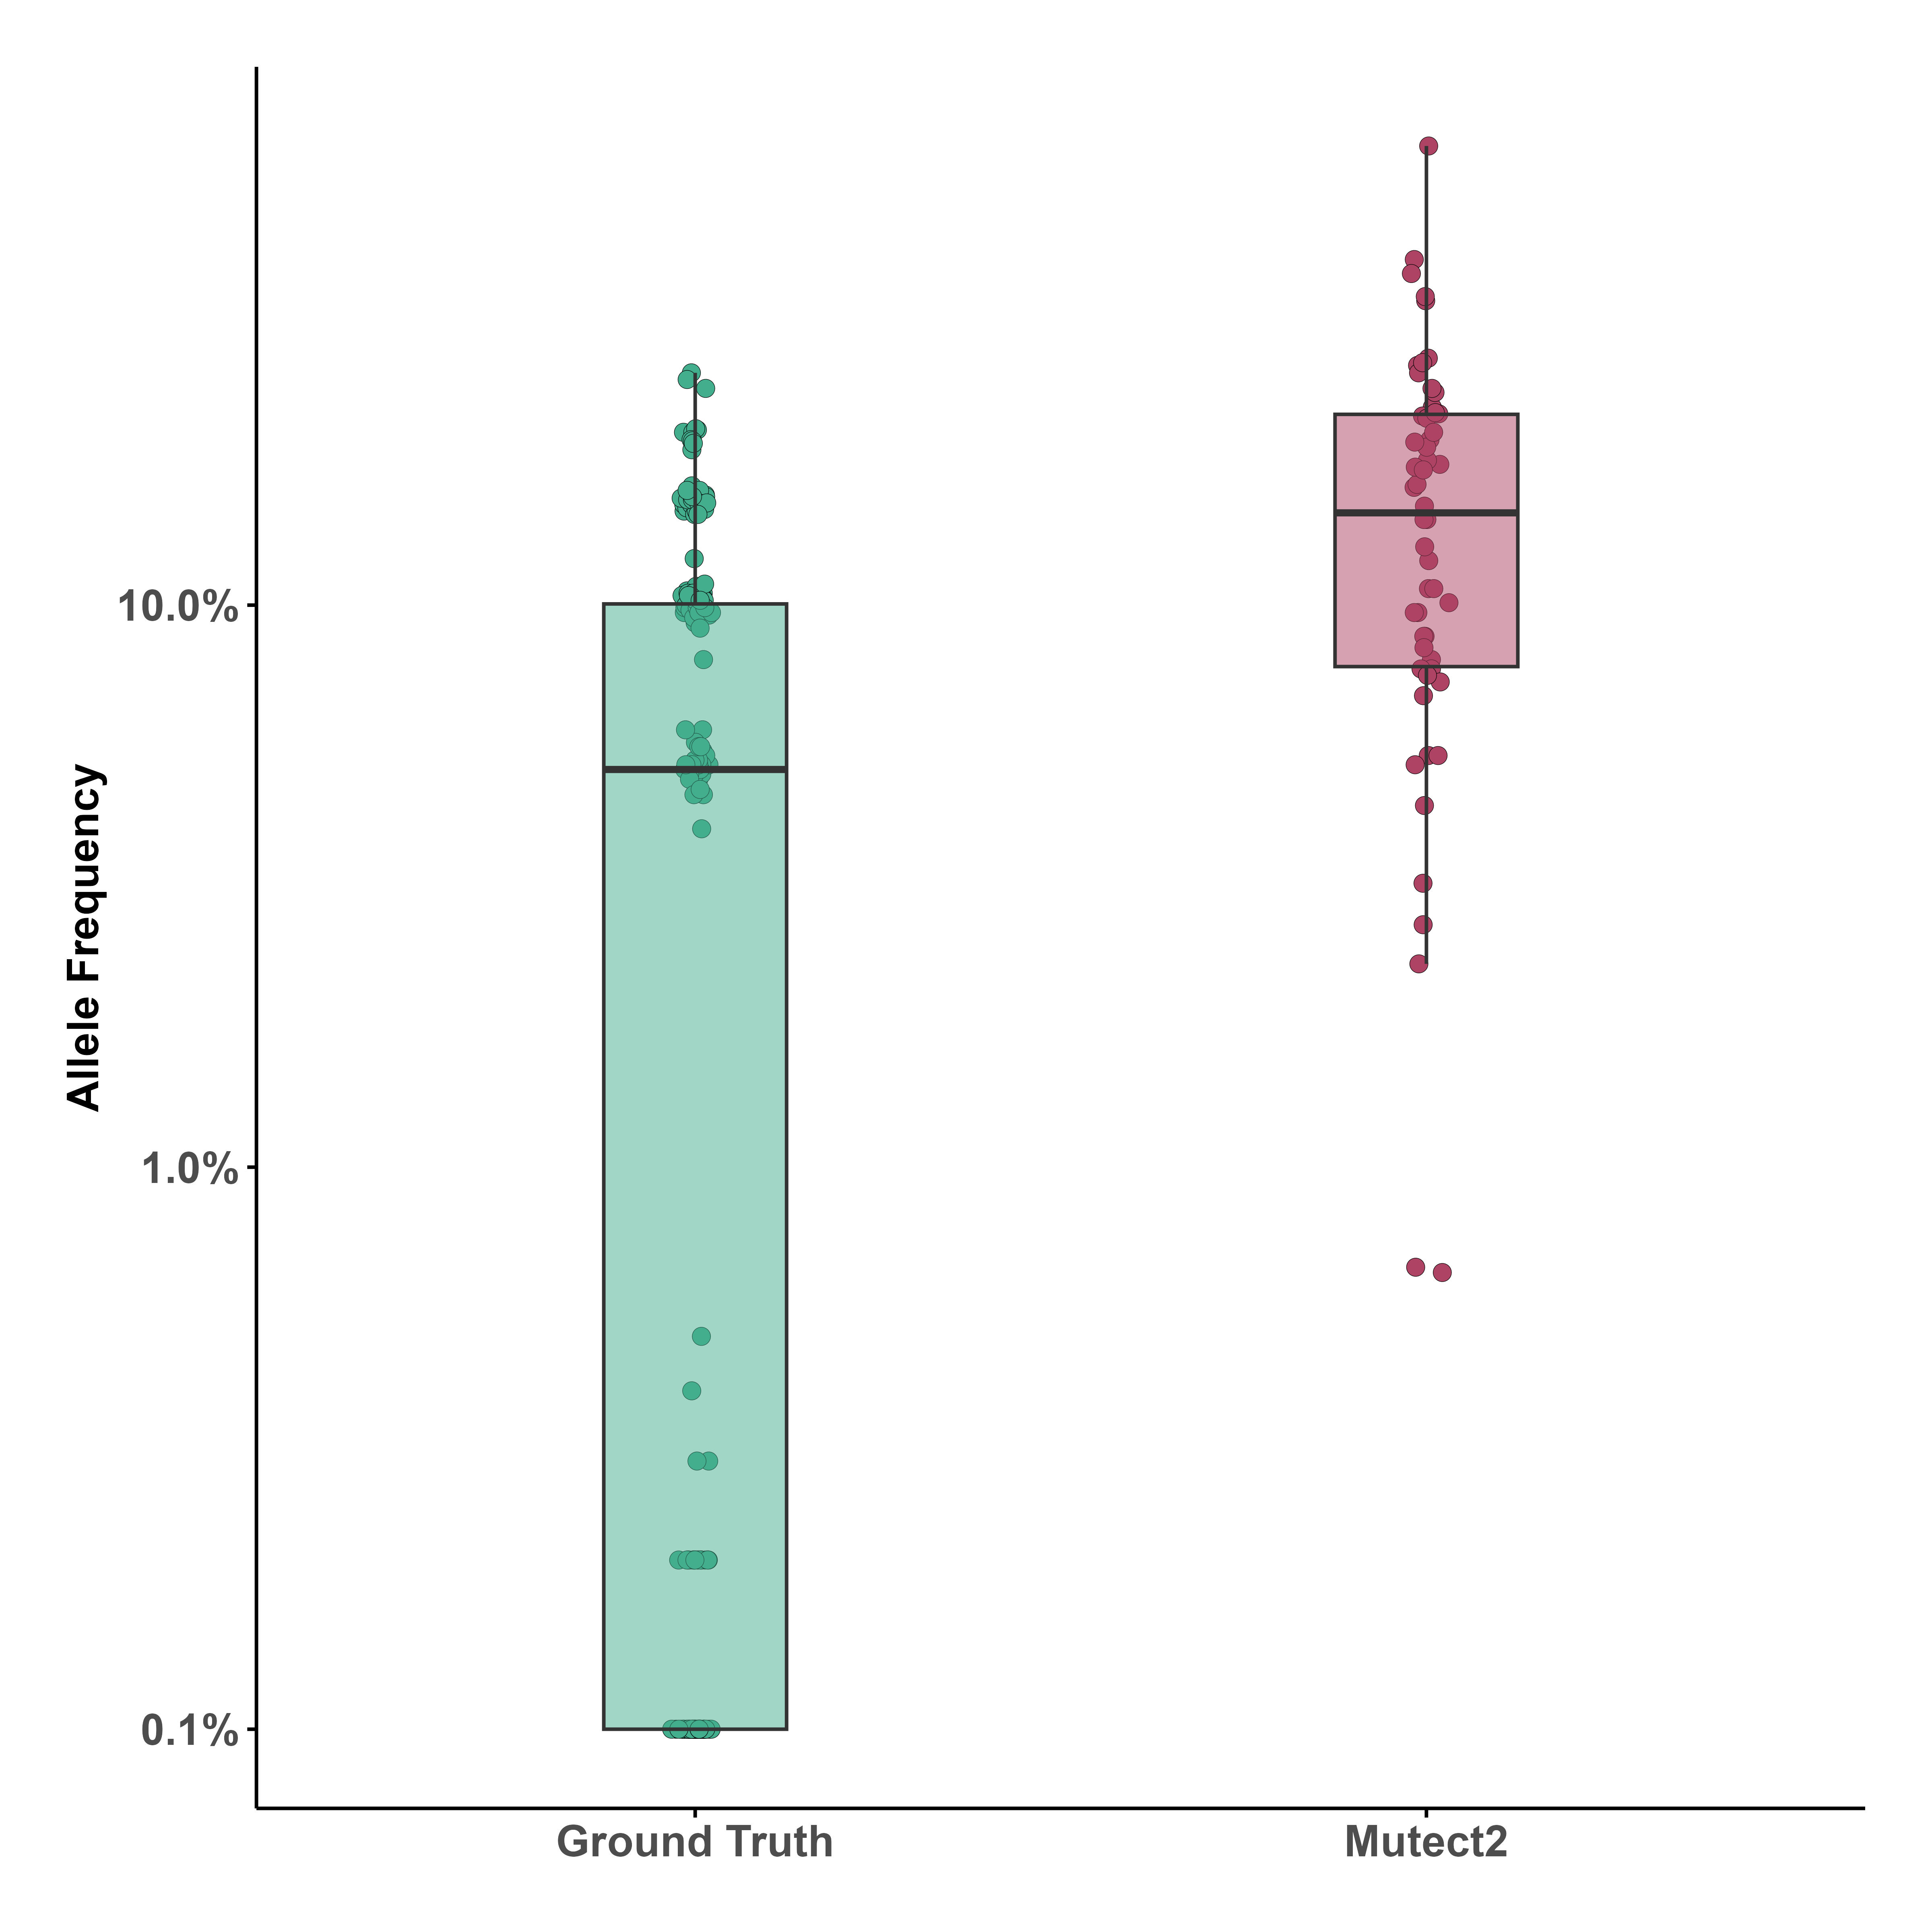
Benchmarking GATK-Mutect2
Down-sampling of coverage of «Ground Truth» Variants
Differences in AF of «Ground Truth» Variants
Variance in AF Density plots of «Ground Truth» Variants per DNA Base

Slide 6
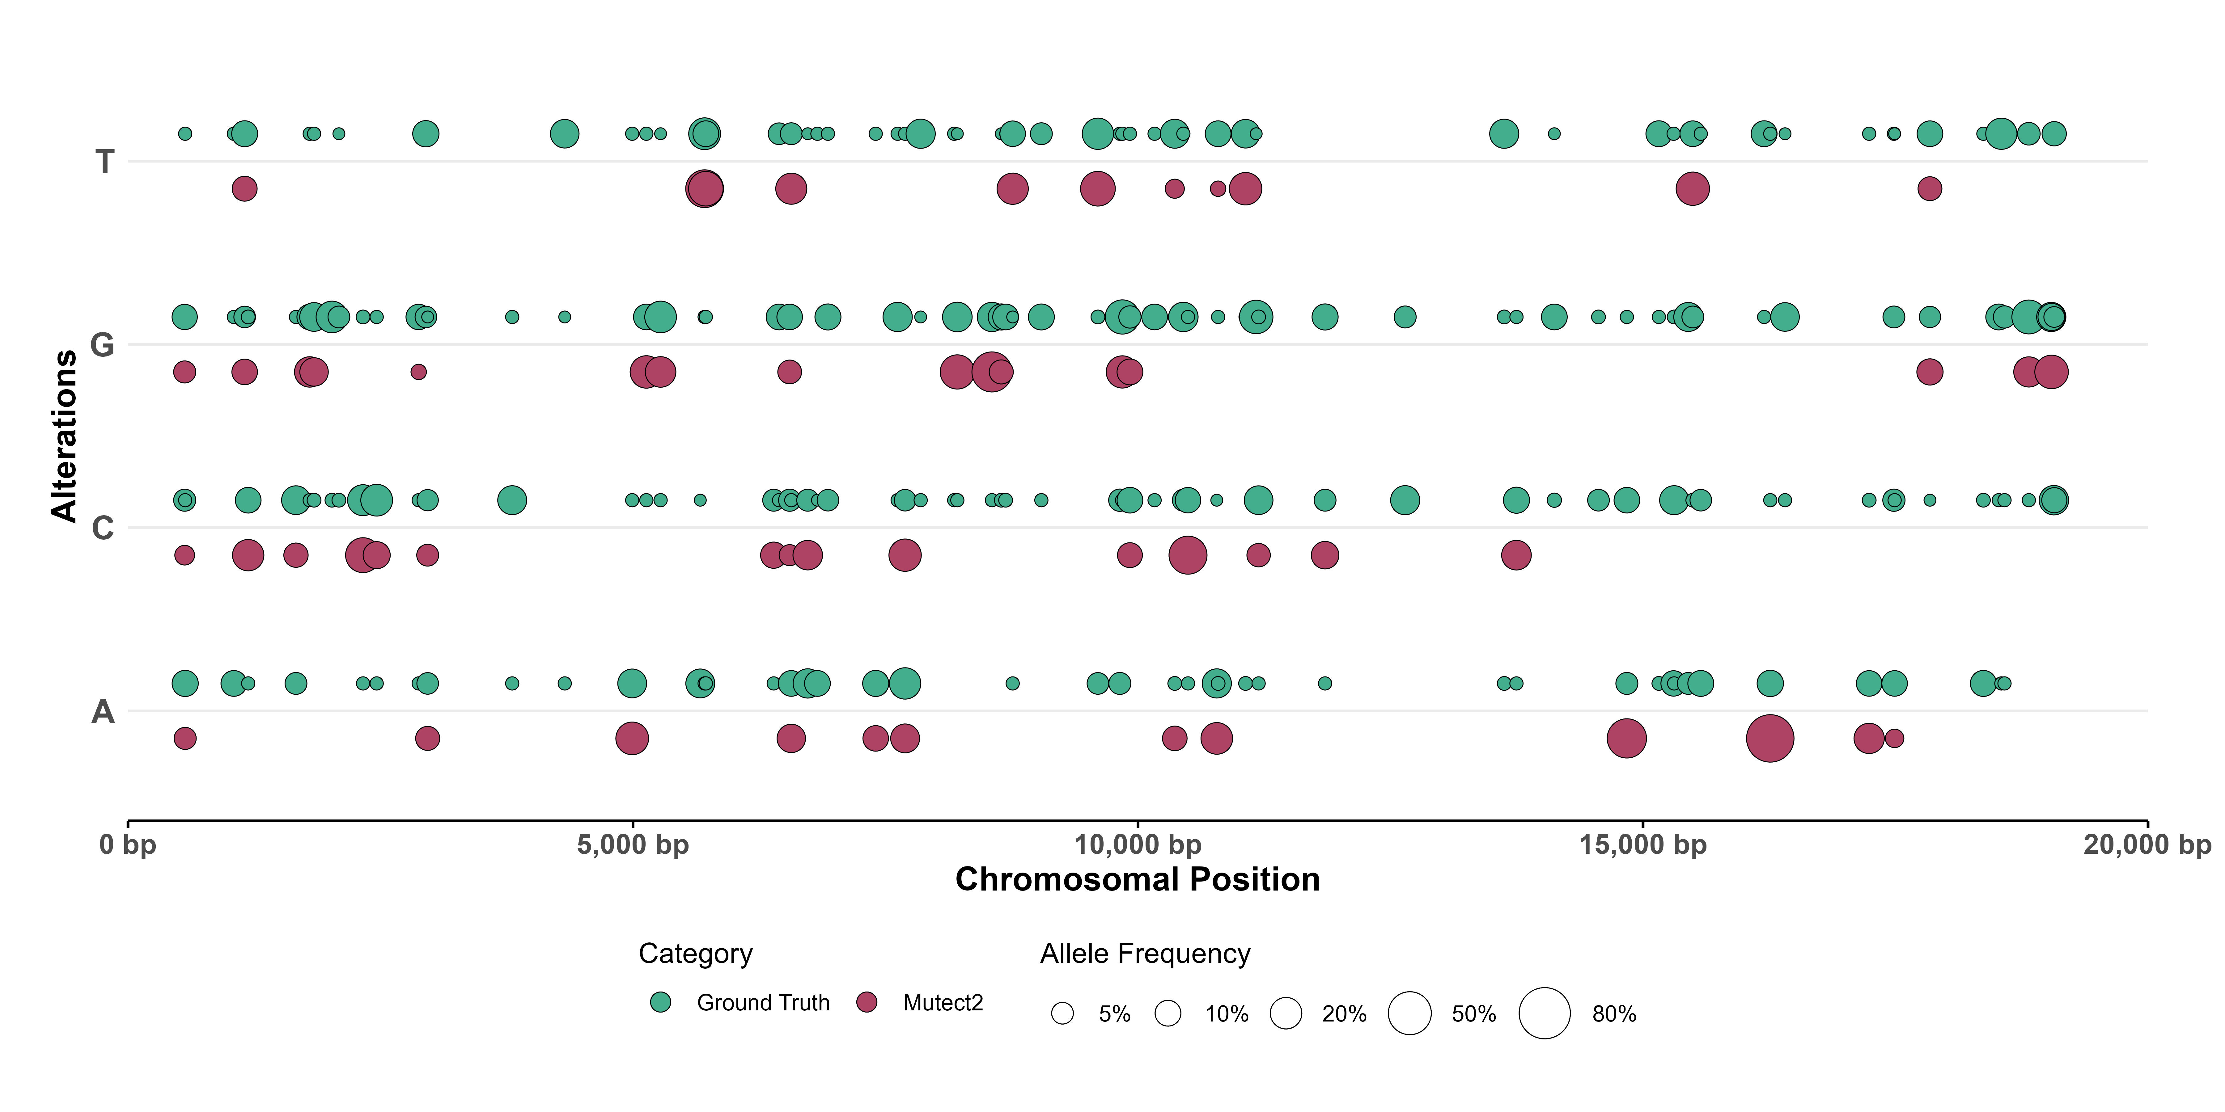
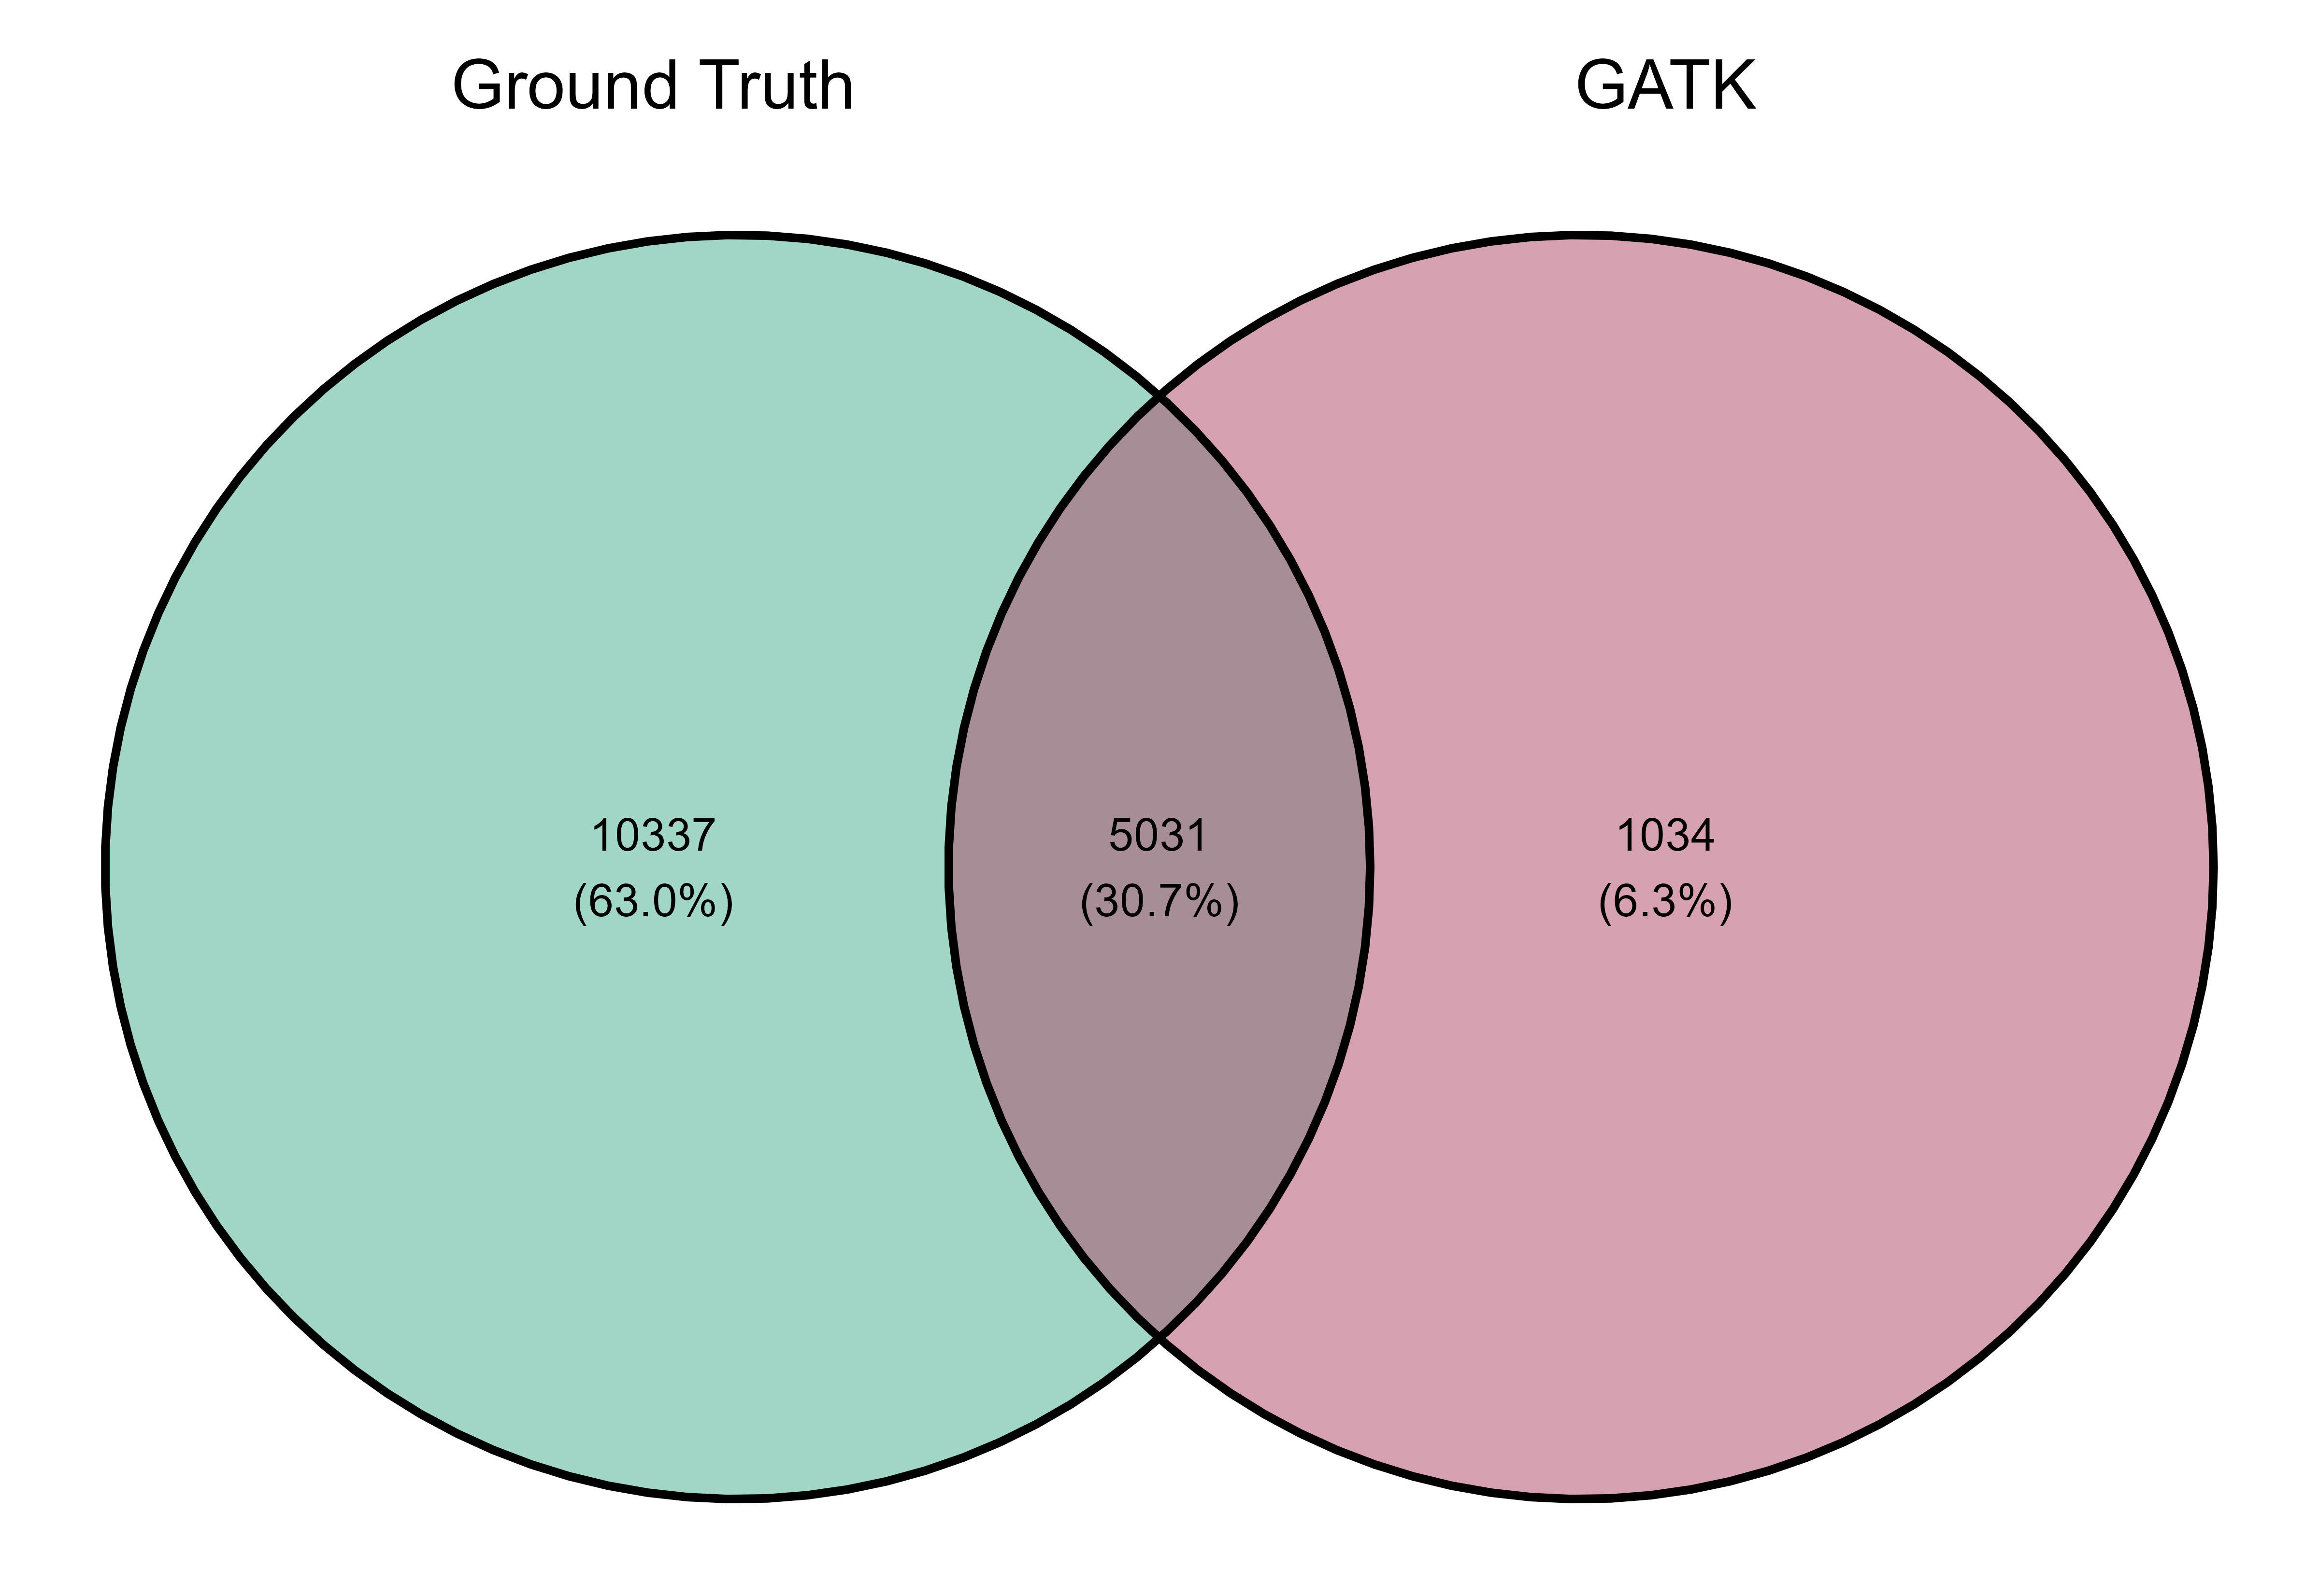
Benchmarking GATK-Mutect2
Divergence in the identification of SNIPs and their AF of «Ground Truth» Variants
Venn plot of the Overall Variants

Slide 7
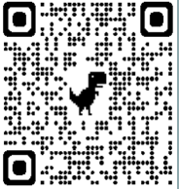
Highlights
To learn more about our work please visit
Generation of synthetic genomics data based on TP53 gene
Define «Ground Truth» SNIPs and INDELs in order to benchmark somatic variant callers
Investigate the impact of variant callers in variants at low frequencies

Slide 8
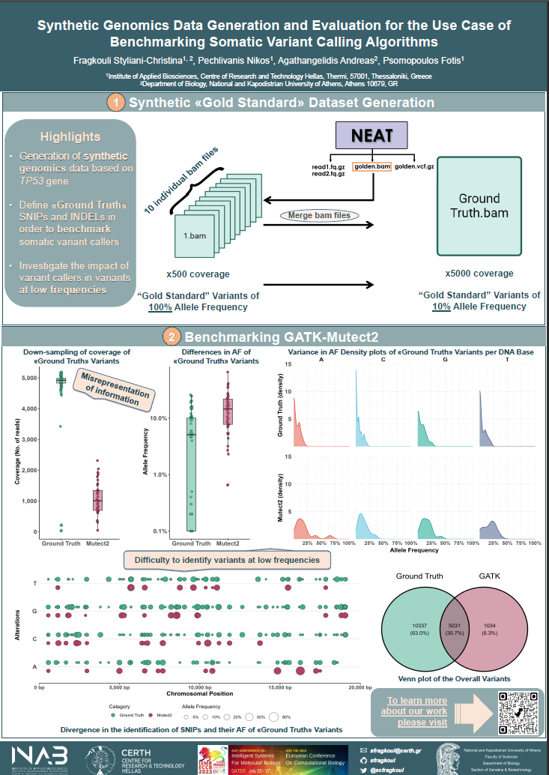
Come say Hi :)
Monday 24th of July
Poster Session A
Track: BOSC
Poster: A-102

